Slide 1
Chapter 1: Introduction

Slide 2
What is an Operating System?
A program that acts as an intermediary between a user of a computer and the computer hardware
Operating system goals:
  Execute user programs and make solving user problems easier
  Make the computer system convenient to use
  Use the computer hardware in an efficient manner

Slide 3
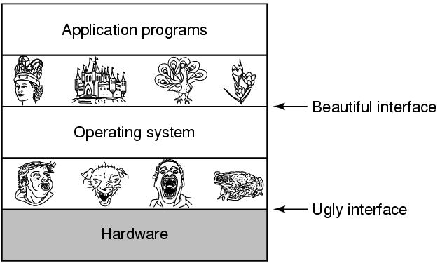
The Operating System as an Extended Machine
An Operating System gives a beautiful interface to the existing hardware system and acts as an Extended Machine.
Tanenbaum, Modern Operating Systems 3 e, (c) 2008 Prentice-Hall, Inc. All rights reserved. 0-13-6006639

Slide 4
Computer System Structure
Computer system can be divided into four components:
  Hardware – provides basic computing resources
    CPU, memory, I/O devices
  Operating system
    Controls and coordinates use of hardware among various applications and users
  Application programs – define the ways in which the system resources are used to solve the computing problems of the users
    Word processors, compilers, web browsers, database systems, video games
  Users
    People, machines, other computers

Slide 5

Computer System Organization
Computer-system operation
  One or more CPUs, device controllers connect through common bus providing access to shared memory
  Concurrent execution of CPUs and devices competing for memory cycles

Slide 6

Four Components of a Computer System

Slide 7
What Operating Systems Do
Depends on the point of view
Users want convenience, ease of use and good performance
  Don’t care about resource utilization
But shared computer such as mainframe or minicomputer must keep all users happy
Users of dedicate systems such as workstations have dedicated resources but frequently use shared resources from servers
Handheld computers are resource poor, optimized for usability and battery life
Some computers have little or no user interface, such as embedded computers in devices and automobiles

Slide 8
Operating System Definition
OS is a resource allocator
  Manages all resources
  Decides between conflicting requests for efficient and fair resource use
OS is a control program
  Controls execution of programs to prevent errors and improper use of the computer

Slide 9
Operating System Definition (Cont.)
No universally accepted definition
“Everything a vendor ships when you order an operating system” is a good approximation
  But varies wildly
“The one program running at all times on the computer” is the kernel.
Part of the operating system that loads first, and it remains in main memory.
The kernel code is usually loaded into a protected area of memory to prevent it from being overwritten by programs or other parts of the operating system.
Typically, the kernel is responsible for memory management, process and task management, and disk management. The kernel connects the system hardware to the application software.

Slide 10
Operating System Definition (Cont.)
Everything else is either
  a system program (ships with the operating system) , or
  an application program.

Slide 11
Computer Startup
Bootstrap program is loaded at power-up or reboot
  Typically stored in ROM or EPROM, generally known as firmware
  Initializes all aspects of system
  Loads operating system kernel and starts execution

Slide 12
Computer-System Operation
I/O devices and the CPU can execute concurrently
Each device controller is in charge of a particular device type
Each device controller has a local buffer
CPU moves data from/to main memory to/from local buffers
I/O is from the device to local buffer of controller
Device controller informs CPU that it has finished its operation by causing an interrupt

Slide 13
Common Functions of Interrupts
Interrupt transfers control to the interrupt service routine generally, through the interrupt vector, which contains the addresses of all the service routines
Interrupt architecture must save the address of the interrupted instruction
A trap or exception is a software-generated interrupt caused either by an error or a user request
An operating system is interrupt driven

Slide 14
Interrupt Handling
The operating system preserves the state of the CPU by storing registers and the program counter
Determines which type of interrupt has occurred:
  polling
  vectored interrupt system
Separate segments of code determine what action should be taken for each type of interrupt

Slide 15
Operating System Structure
Multiprogramming (Batch system) needed for efficiency
  Single user cannot keep CPU and I/O devices busy at all times
  Multiprogramming organizes jobs (code and data) so CPU always has one to execute
  A subset of total jobs in system is kept in memory
  One job selected and run via job scheduling
  When it has to wait (for I/O for example), OS switches to another job
Timesharing (multitasking) is logical extension in which CPU switches jobs so frequently that users can interact with each job while it is running, creating interactive computing
  Response time should be < 1 second
  Each user has at least one program executing in memory process
  If several jobs ready to run at the same time  CPU scheduling

Slide 16

Memory Layout for Multiprogrammed System

Slide 17
Operating-System Operations (cont.)
Dual-mode operation allows OS to protect itself and other system components
  User mode and kernel mode
  Mode bit provided by hardware
    Provides ability to distinguish when system is running user code or kernel code
    Some instructions designated as privileged, only executable in kernel mode
    System call changes mode to kernel, return from call resets it to user
Increasingly CPUs support multi-mode operations
  i.e. virtual machine manager (VMM) mode for guest VMs

Slide 18
Operating System Concepts
Process
Program in execution
Lives in address space
Process table
  Keeps info about process
  Used to re-start process

Slide 19

A Process Tree
Ex: MS-Word creating child process
Process creates child processes
Tree structure
Tanenbaum, Modern Operating Systems 3 e, (c) 2008 Prentice-Hall, Inc. All rights reserved. 0-13-6006639

Slide 20
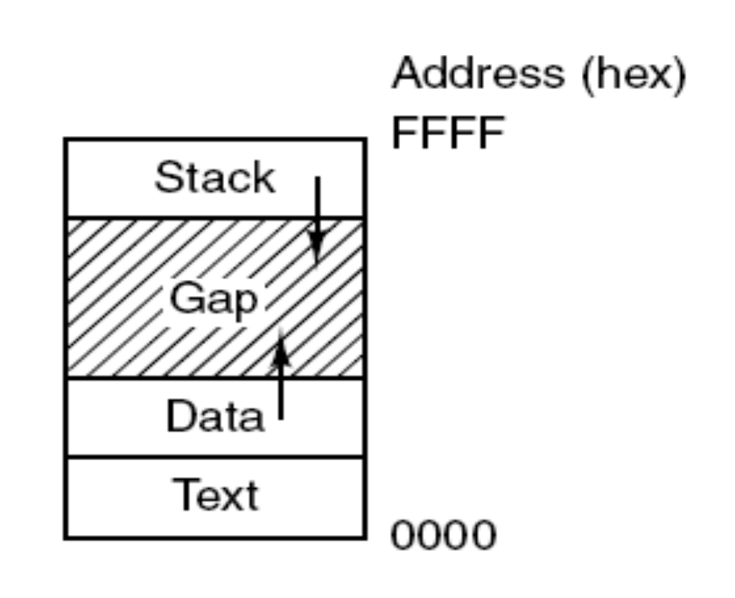
Memory Layout
Processes have three segments:
text, data, and stack.
Tanenbaum, Modern Operating Systems 3 e, (c) 2008 Prentice-Hall, Inc. All rights reserved. 0-13-6006639

Slide 21
Process
Can communicate with one another
Have UID’s and group ID’s (GID)
Can communicate with one another (IPC)
Tanenbaum, Modern Operating Systems 3 e, (c) 2008 Prentice-Hall, Inc. All rights reserved. 0-13-6006639

Slide 22
System Calls
Interface between user programs and OS
Varies from OS to OS
System call issued by user program
Call uses a library call of the same name
Library routine puts machine into kernel modes (by issuing a special instruction)
Finds actual routine for system call in a table
Does the work involved in the call
Returns to user program
Tanenbaum, Modern Operating Systems 3 e, (c) 2008 Prentice-Hall, Inc. All rights reserved. 0-13-6006639

Slide 23

Transition from User to Kernel Mode

Slide 24
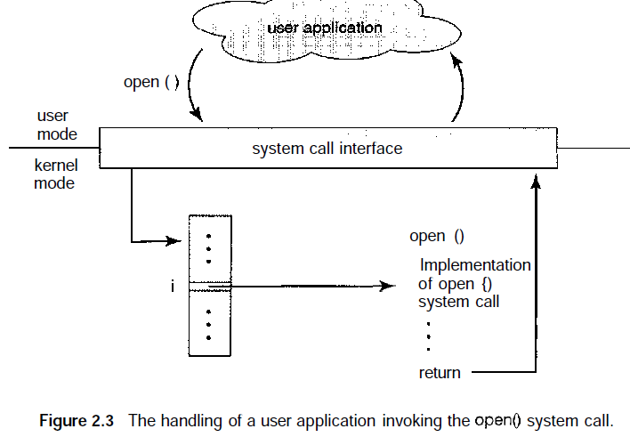
Transition from User to Kernel Mode

Slide 25
Types of System Calls
Five major categories
Process control
  end, abort
  load, execute
  create process, terminate process
  get process attributes, set process attributes
  wait for time
  wait event, signal event
  allocate and free memory
File manipulation
  create file, delete file
  open, close
  read, write, reposition
  get file attributes, set file attributes
GALVIN – Chapter 2
Page: 47-54
Tanenbaum, Modern Operating Systems 3 e, (c) 2008 Prentice-Hall, Inc. All rights reserved. 0-13-6006639

Slide 26
Types of System Calls
Device manipulation
  request device, release device
  read, write, reposition
  get device attributes, set device attributes
  logically attach or detach devices
Information maintenance
  get time or date, set time or date
  get system data, set system data
  get process, file, or device attributes
  set process, file, or device attributes
Communications
  create, delete communication connection
  send, receive messages
  transfer status information
  attach or detach remote devices
GALVIN – Chapter 2
Page: 47-54
Tanenbaum, Modern Operating Systems 3 e, (c) 2008 Prentice-Hall, Inc. All rights reserved. 0-13-6006639

Slide 27
Unix Read System Call
Count = read(fd, buffer, nbytes)
  fd is a file descriptor. When a file is opened, permissions are checked. If access is allowed, a number (fd) is returned. Then file can be read/written
  nbytes is number of bytes in file
  buffer is where read deposits the bytes
Tanenbaum, Modern Operating Systems 3 e, (c) 2008 Prentice-Hall, Inc. All rights reserved. 0-13-6006639

Slide 28

System Calls
read(fd, buffer, nbytes).
Tanenbaum, Modern Operating Systems 3 e, (c) 2008 Prentice-Hall, Inc. All rights reserved. 0-13-6006639

Slide 29
Fork
Pid=fork( )
  Duplicates parent process completely Everything duplicated -data, registers, fd’s
  Fork returns a value (pid)
    Zero in child
    Child’s PID in parent
    Used to differentiate child from parent
** Copy of Chrome browser / Ms word window / Server process
Tanenbaum, Modern Operating Systems 3 e, (c) 2008 Prentice-Hall, Inc. All rights reserved. 0-13-6006639

Slide 30
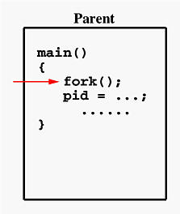
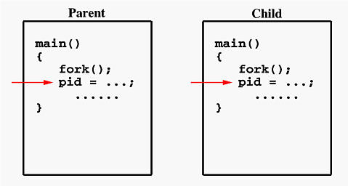
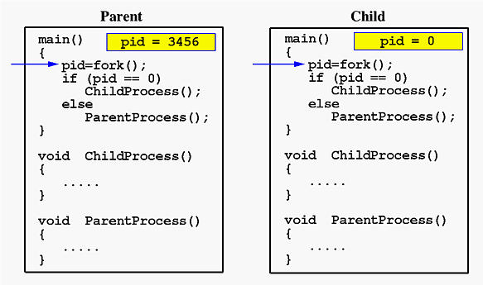
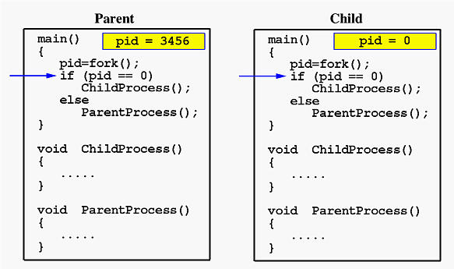
Fork

Slide 31
Fork
#include <stdio.h>
#include <sys/types.h>
#define MAX_COUNT 200
void ChildProcess(void); /* child process prototype */
void ParentProcess(void); /* parent process prototype */
void main(void)
{
pid_t pid;
pid = fork();
if (pid == 0)
ChildProcess();
else
ParentProcess();
}
void ChildProcess(void)
{
int i;
for (i = 1; i <= MAX_COUNT; i++)
printf(" This line is from child, value = %d\n", i);
printf(" *** Child process is done ***\n");
}
void ParentProcess(void)
{
int i;
for (i = 1; i <= MAX_COUNT; i++)
printf("This line is from parent, value = %d\n", i);
printf("*** Parent is done ***\n");
}
Process ID 1 is usually the init process primarily responsible for starting and shutting down the system.
If a parent process is killed, the child processes are shifted as the child of init process

Slide 32
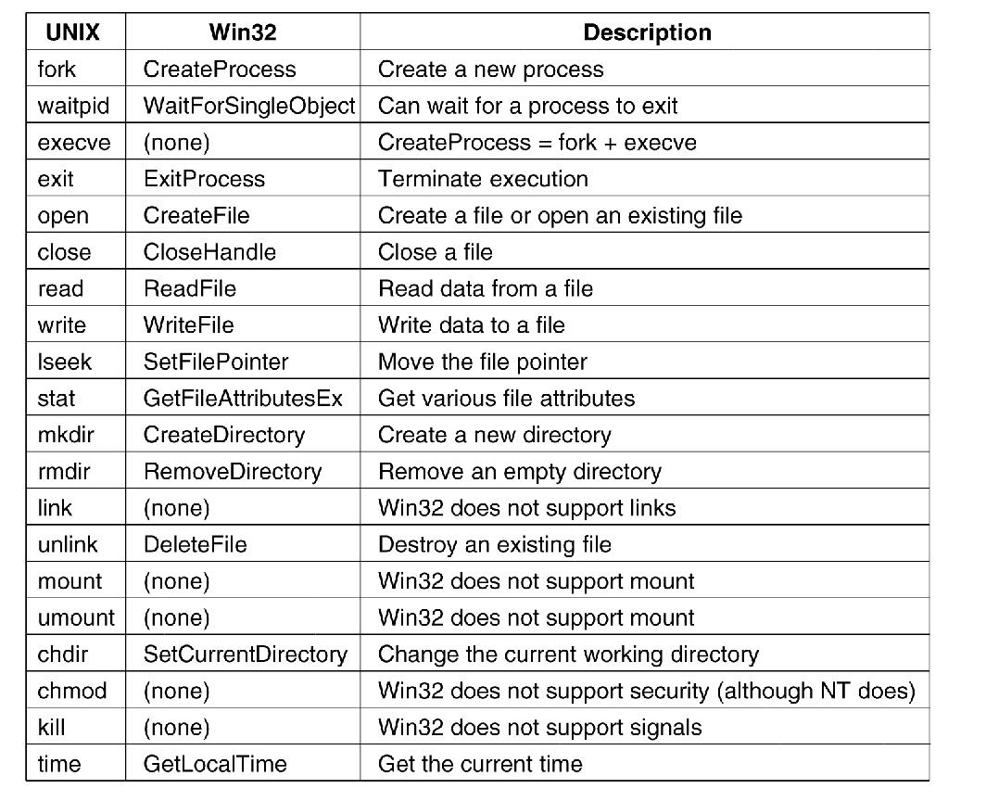
Windows Win32 API
The Win32 API calls that roughly correspond
to the UNIX calls
Tanenbaum, Modern Operating Systems 3 e, (c) 2008 Prentice-Hall, Inc. All rights reserved. 0-13-6006639

Slide 33



Kernel Data Structures
Many similar to standard programming data structures
Singly linked list
Doubly linked list
Circular linked list

Slide 34

Kernel Data Structures
Hash function can create a hash map
Bitmap – string of n binary digits representing the status of n items
Linux data structures defined in
include files <linux/list.h>, <linux/kfifo.h>, <linux/rbtree.h>

Slide 35
Memory Management
To execute a program all (or part) of the instructions must be in memory
All (or part) of the data that is needed by the program must be in memory.
Memory management determines what is in memory and when
  Optimizing CPU utilization and computer response to users
Memory management activities
  Keeping track of which parts of memory are currently being used and by whom
  Deciding which processes (or parts thereof) and data to move into and out of memory
  Allocating and deallocating memory space as needed

Slide 36
Storage Management
OS provides uniform, logical view of information storage
  Abstracts physical properties to logical storage unit - file
  Each medium is controlled by device (i.e., disk drive, tape drive)
    Varying properties include access speed, capacity, data-transfer rate, access method (sequential or random)
File-System management
  Files usually organized into directories
  Access control on most systems to determine who can access what
  OS activities include
    Creating and deleting files and directories
    Primitives to manipulate files and directories
    Mapping files onto secondary storage
    Backup files onto stable (non-volatile) storage media

Slide 37
Mass-Storage Management
Usually disks used to store data that does not fit in main memory or data that must be kept for a “long” period of time
Proper management is of central importance
Entire speed of computer operation hinges on disk subsystem and its algorithms
OS activities
  Free-space management
  Storage allocation
  Disk scheduling
Some storage need not be fast
  Tertiary storage includes optical storage, magnetic tape
  Still must be managed – by OS or applications
  Varies between WORM (write-once, read-many-times) and RW (read-write)

Slide 38
Operating Systems Architecture
Monolithic systems
A main program that invokes the requested service procedure.
A set of service procedures that carry out the system calls.
A set of utility procedures that help the service procedures.
All the basic system services like process and memory management, interrupt handling etc. are packaged into a single module in kernel space.
Tanenbaum, Modern Operating Systems 3 e, (c) 2008 Prentice-Hall, Inc. All rights reserved. 0-13-6006639

Slide 39
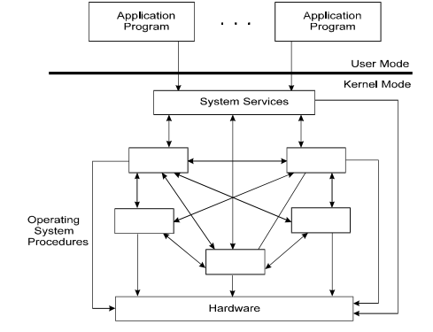
Monolithic systems

Slide 40
Monolithic systems
Drawbacks
1) Size of kernel is huge.
2) Poor maintainability, which means bug fixing or addition of new features resulted in recompilation of the whole kernel which could consume hours
3) A crash in any of these procedures will take down the entire operating system
Modern day approach:
> The kernel consists of different modules which can be dynamically loaded and un-loaded.
> This modular approach allows easy extension of OS's capabilities.

Slide 41
Monolithic systems
Maintainability of kernel became very easy
  Only the concerned module needs to be loaded and unloaded every time there is a change or bug fix in a particular module.
> No need to bring down and recompile the whole kernel for a smallest bit of change.
Stripping of kernel for various platforms became very easy
  Can easily unload the module that we do not want.
MS-Dos, Windows 9x, Linux, Android

Slide 42
Microkernels
Small number of processes are allowed in the kernel
  Managing memory protection
  Process scheduling
  Inter Process communication (IPC)
Device driver management, protocol stack, file system etc. may run in the user space ( They are called servers and loaded during the time the OS boots-up)
  Microkernel servers are daemon programs
  The Kernel grants some of them privileges to interact with parts of physical memory that are otherwise off limits to most programs.
  This allows some servers, particularly device drivers, to interact directly with hardware.
Tanenbaum, Modern Operating Systems 3 e, (c) 2008 Prentice-Hall, Inc. All rights reserved. 0-13-6006639

Slide 43
Microkernels
Minimizes effects of bugs *Galvin Chapter 2 , 2.7.3
  Don’t want bug in driver to crash system
  Ex: Network service crashes due to buffer overflow, then only the networking service's memory would be corrupted, leaving the rest of the system still functional.
Reduces the kernel code size and increases the security and stability of OS.
Servers communicate through Inter-process communication / Message passing
Microkernels can suffer from performance decreases due
to increased system function overhead
Ex: Mac OS X, Windows XP, NT, Windows 7 etc.
Tanenbaum, Modern Operating Systems 3 e, (c) 2008 Prentice-Hall, Inc. All rights reserved. 0-13-6006639

Slide 44
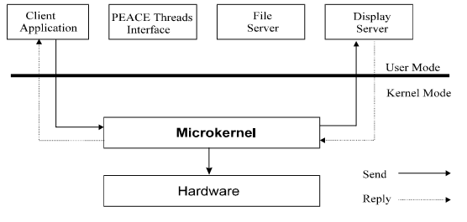
Microkernels
Tanenbaum, Modern Operating Systems 3 e, (c) 2008 Prentice-Hall, Inc. All rights reserved. 0-13-6006639

Slide 45
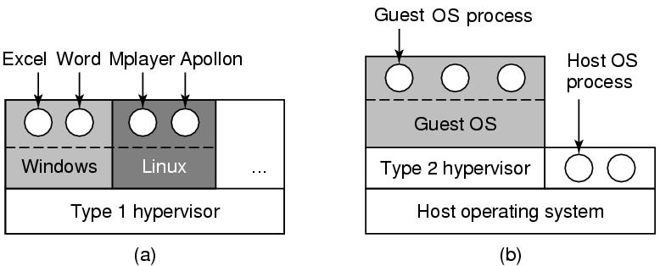
Virtual Machines
Type 2 hypervisors run on a host operating system. When the virtualization movement first began to take off, Type 2 hypervisors were most popular. Administrators could buy the software and install it on a server they already had.
Examples of this type of hypervisor include
VMware Fusion, Oracle Virtual Box, Oracle VM for x86, Solaris Zones, Parallels and VMware Workstation

Slide 46
Virtual Machines
virtualize the hardware of the machine
Type 1 hypervisors run directly on the system hardware. They are often referred to as a "native" or "bare metal" or "embedded" hypervisors in vendor literature.
is installed directly on physical host server hardware just like an operating system.
Type 1 hypervisors provide higher performance, availability, and security than Type 2 hypervisors
Type 1 hypervisors run on dedicated hardware. They require a management console and are used in data centers. Examples of this type of hypervisor include Oracle OVM for SPARC, ESXi, Hyper-Vand KVM
Tanenbaum, Modern Operating Systems 3 e, (c) 2008 Prentice-Hall, Inc. All rights reserved. 0-13-6006639

Slide 47
** Did you hear about JVM ??
JVM attempts to abstract the hardware and machine itself so the developer doesn't have to concern themselves with things like architecture type or platform. Software built with Java should run on any platform that has the proper JVM version installed, regardless of physical machine type.
The JVM runs Java applications, while VMWare runs full operating systems

Slide 48
Exokernels
Exokernel is an operating system kernel developed by the MIT Parallel and Distributed Operating Systems group
Rather than cloning the actual machine
> Giving each user a subset of the resources.
> One virtual machine might get disk blocks 0 to 1023, the
next one might get blocks 1024 to 2047, and so on.
At the bottom layer, running in kernel mode, is a program called the exokernel.
> Its job is to allocate resources to virtual machines and
then check attempts to use them to make sure no machine
is trying to use somebody else’s resources. Each user-
level virtual machine can run its own operating system,

Slide 49
Exokernels
>> The advantage of the exokernel scheme is that it saves a layer of mapping. In the other designs, each virtual machine thinks it has its own disk.

Slide 50

Computing Environments – Client-Server
Client-Server Computing
  Dumb terminals supplanted by smart PCs
  Many systems now servers, responding to requests generated by clients
    Compute-server system provides an interface to client to request services (i.e., database)
    File-server system provides interface for clients to store and retrieve files

Slide 51
End of Chapter 1

